Slide 1
Digital System Design CE 325 L1 SPRING 2024
Instructor : Dr. Syed Arsalan Jawed
Associate Professor of Practice
arsalan.jawed@sse.habib.edu.pk
Room : W-301
Office Hours : Monday 0930-1030, Wednesday 1430-1530, Friday 0930-1030

Slide 2
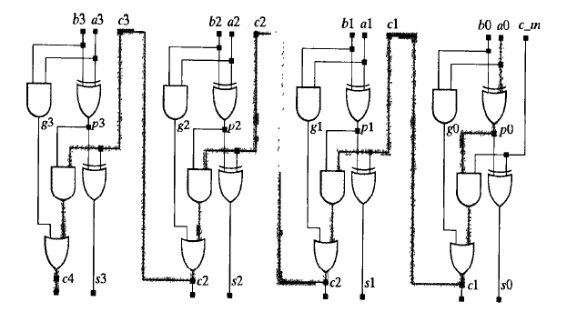
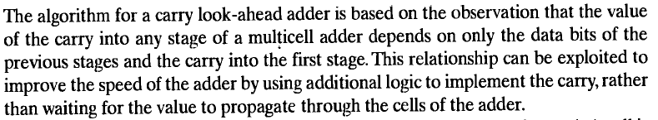
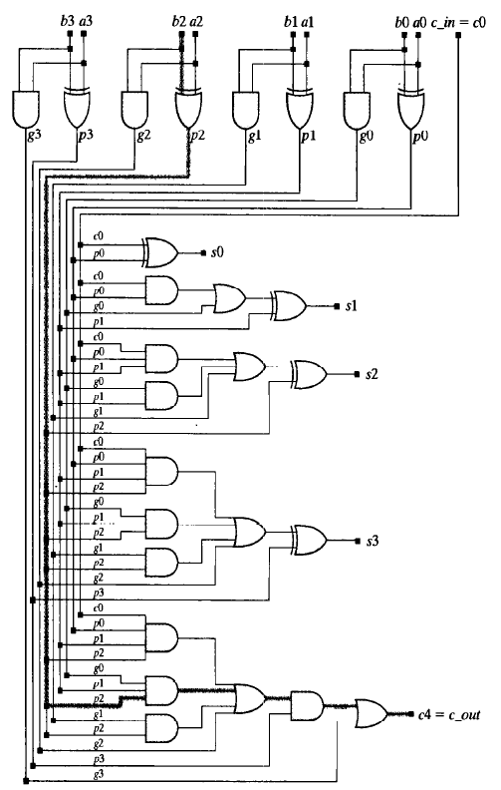


Architectures for Arithmetic Processors
Carry Propagation Adder Carry Look Ahead Adder

Slide 3
In your upcoming projects, implement and use your own Carry Look Ahead Adder
Tighten the clock synthesis frequency
Check where CPA becomes a bottleneck
Replace it with CLA
Run it at a faster clock

Slide 4
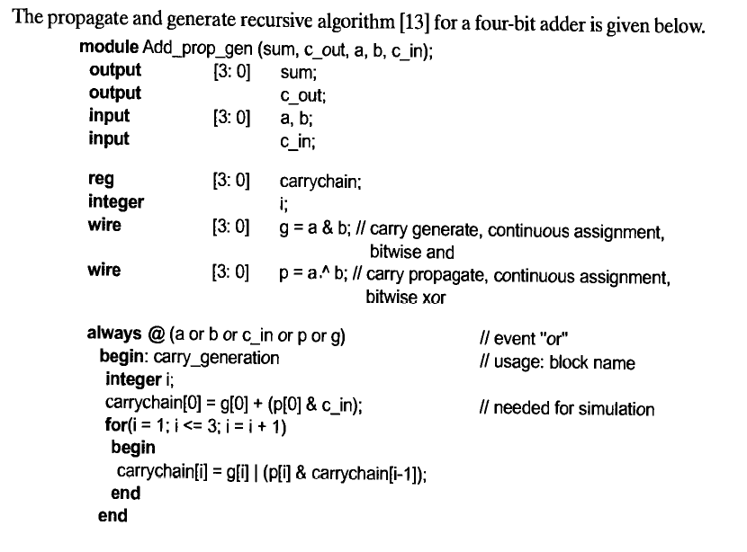

Slide 5
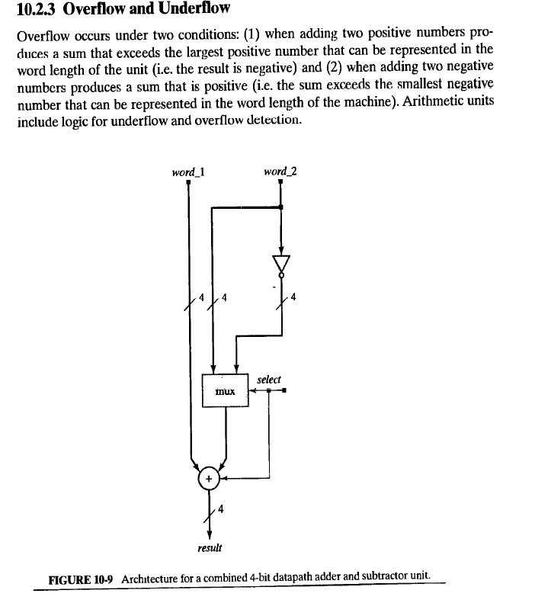

Slide 6
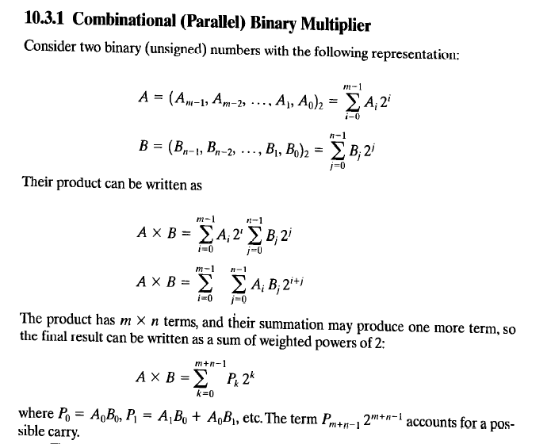
Functional Units for Multiplication

Slide 7
